Slide 1
RECURRENT NEURAL NETWORKS

Slide 2
MEMBERS
Lữ Thị Thúy Quỳnh
Bùi Văn Thuận
Lê Trần Hữu Phước

Slide 3
Table of contents
01
Introduction
02
Recurrent neural networks
BPTT and Vanishing/ Exploding Gradients
03

Slide 4
1. INTRODUCTION

Slide 5
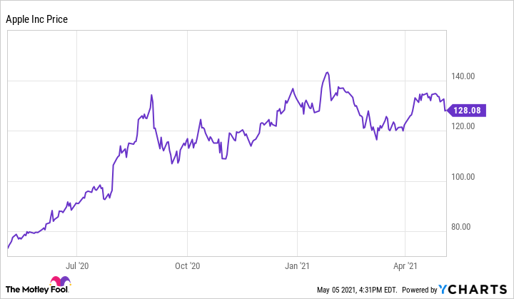
Problem 1: Prediction stock price

Slide 6

Problem 2: Speech-to-text and text-to-speech

Slide 7
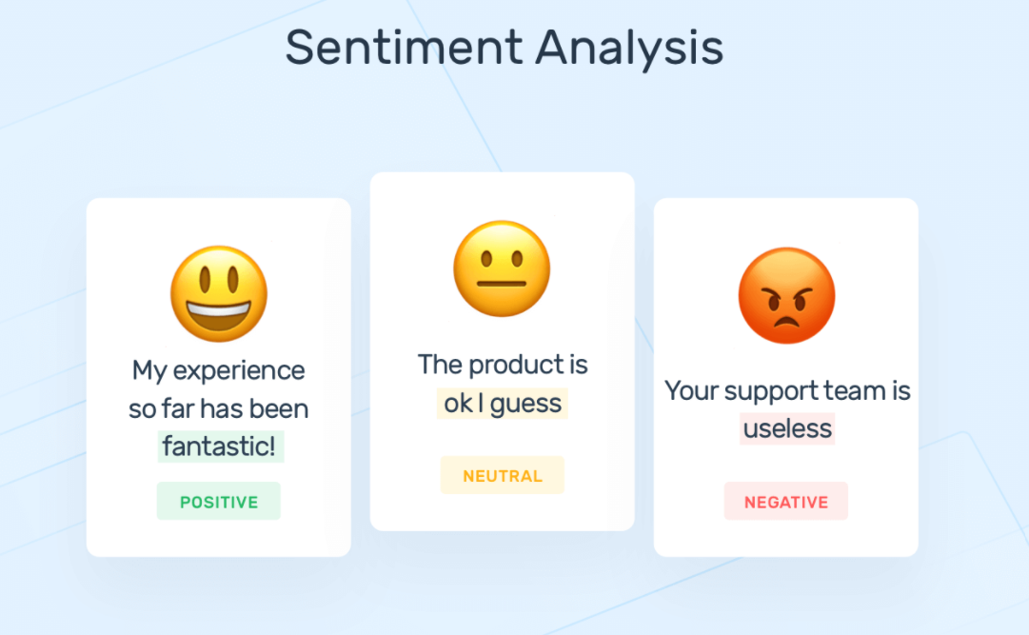
Problem 3: Sentiment analysis

Slide 8
SOLUTION ?
Recurrent neural networks
Recurrent neural networks (RNNs) are designed for studying the sequence of data provided in patterns.
Because Recurrent neural networks is a type of neural network in which the output form the previous step is fed as input to the current step

Slide 9


2. Recurrent neural networks
$$h_{t}$$
Language Model
Markov models and n-grams
RNN with Hidden state
RNN architecture
Types of RNN
A
$$X_{t}$$

Slide 10
Language Model
Suppose that we tokenize text data at word level. Let us start by applying basic probability rules:
For example: the probability of text sequence containing four words would be given as:
In order to compute the language model, we need to calculate the probability of words and the conditional probability of a word given the previous few words. Such probabilities are essentially language model parameters.
Notes:
Câu hỏi ở đây là chúng ta nên mô hình hóa một chuỗi văn bản như thế nào? Giả sử rằng dữ liệu ở dạng chuỗi đã được tách thành các từ riêng lẻ, áp dụng công thức xác suất, ta có được:
Với x1, x2, … , xT là lần lượt các từ trong chuỗi sau khi tách có độ dài T, mục đích của language model là tính xác suất đồng thời của các từ trong chuỗi với nhau.

Slide 11
Markov Models and n-grams
A distribution over sequences satisfies the Markov property of first order if: . Higher orders correspond to longer dependencies. This leads to a number of approximations that we could apply to model a sequence:
The probability formulate that involve one, two, and three variables are typically referred to as unigram, bigram, and trigram models, respectively.

Slide 12
Recurrent Neural Network
We use a lantent variable model:
Where: is the hidden state.
In general, the hidden state at any time step t could be computed based on both the current input and the previous hidden state :
For a sufficiently powerful function , the latent variable model is not an approximation. After all, may simply store all the data it has observed so far. However, it could potentially make both computation and storage expensive.

Slide 13
Recurrent Neural Network with Hidden state
Let look at the structure in some datail the formulation of Hidden variable:
is a minibatch of inputs at time step t.
is the hidden variable of time step t
is a new weight parameter to describe how to use the hidden variable of the previous time step in the current time step.
is the bias of the hidden layer

Slide 14
Recurrent Neural Network with Hidden state
There are many different ways for constructing RNNs. RNNs with a hidden state defined by previous are very common. For time step t, the output of the output layer is similar to the computation in the MLP:
Parameters of the RNN include the weights and the bias of the hidden layer, together with the weights and the bias of the output layer.
It is worth mentioning that even at different time steps, RNNs always use these model parameters. Therefore, the parameterization cost of an RNN does not grow as the number of time steps increases.

Slide 15
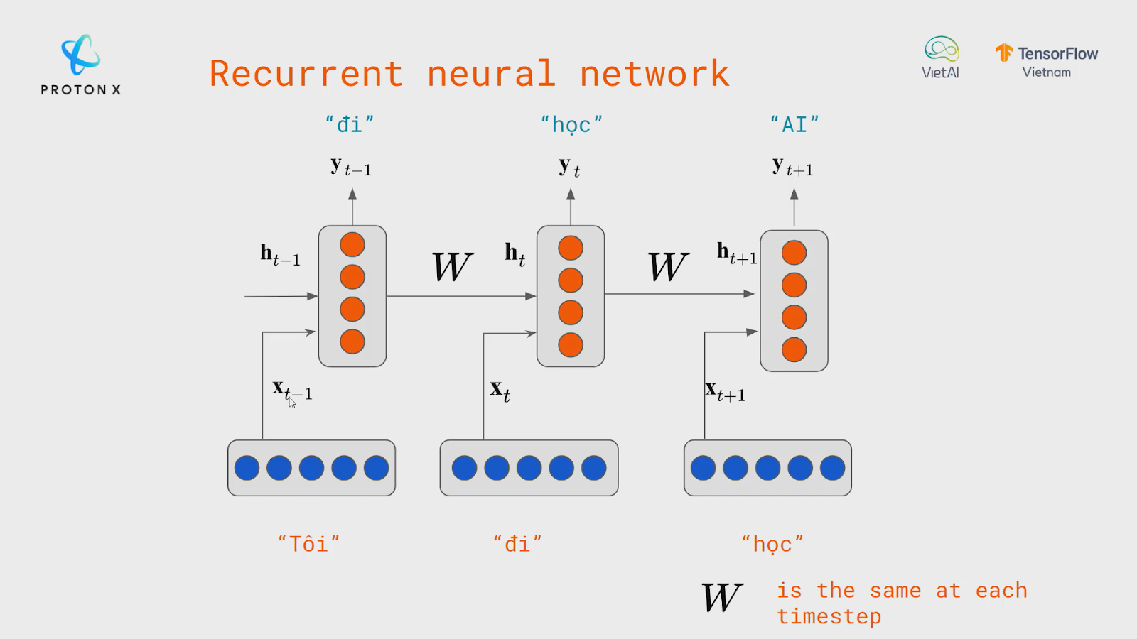
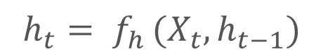


RNNs Architecture

Slide 16
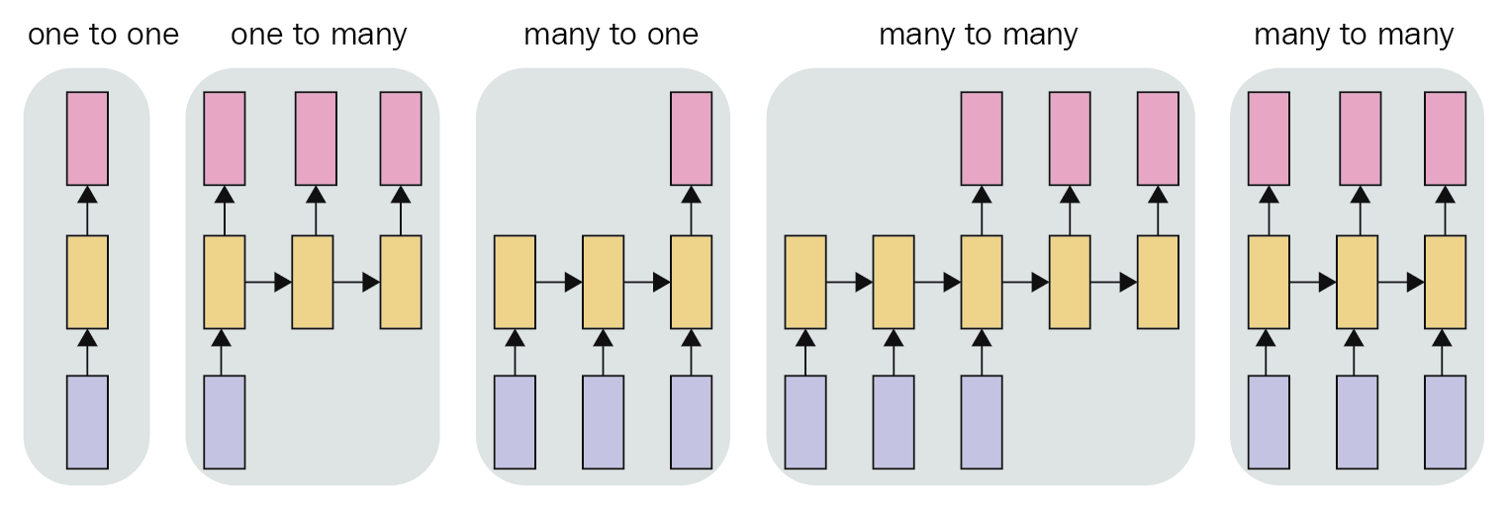
TYPES OF RNNs
multiple output for a single input
e.g. image captioning
input and output layers have the same size
e.g. Video classification on frame level
a single output for a single input
e.g. Image classification.
input and output layers are of different size
e.g. machine translation
multiple inputs are required to give a single output
e.g. sentiment analysis
multiple input and gives multiple output

Slide 17
3. BPTT and vanishing/exploding gradients
BPTT in detail
Vanishing/ exploding gradients problem
Dealing with vanishing/exploding gradient problem
Demo

Slide 18
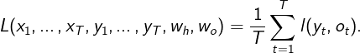
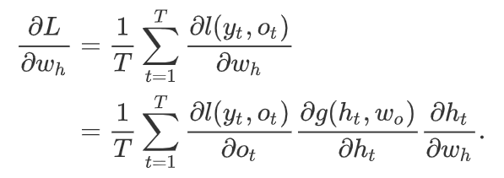
Backpropagation Through Time in detail
We start with a simplified model of how an RNN works. We denote as the hidden state,
as the input and as the output at time step t. Besides, are the weights of hidden layer and the output layer, respectively. As a result, we have:
Hence, we have a chain of values that depend on each other via recurrent computation. The forward propagation is fairly straightforward. All we need is to loop through the triples one time step at a time. The discrepancy between output and the desired label is then evaluated by an objective function across all the T time step as:
For the backpropagation, matters are a bit trickier, especially when we compute the gradients with regard to the parameters of the objective function L. By the chain rule:

Slide 19
Backpropagation Through Time in detail
We will show how to compute the gradients of the objective function with respect to all the decomposed model parameters.
The hidden state and the output are computed as
Where , , are the weight parameters. Denote the loss at time step t. Our objective function, the loss over time steps from the beginning of the sequence is thus:

Slide 20
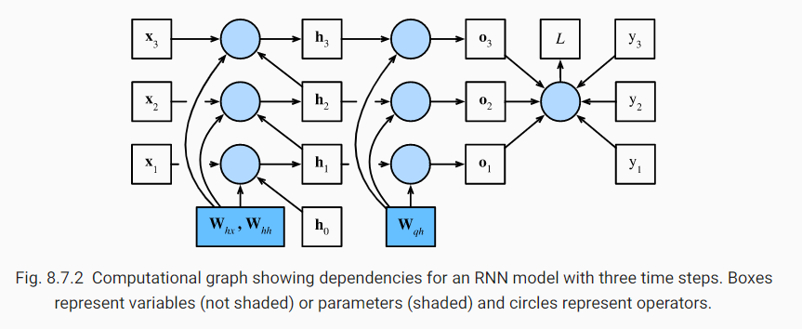
Backpropagation Through Time

Slide 21
Backpropagation Through Time in detail
First of all, differentiating the objective function with respect to the model output at any time step t is straightforward:
Now, we can calculate the gradient of the objective function with respect to the parameter in the output layer: . Based on the last figure, the objective function depends on via . Using the chain rule yields:

Slide 22
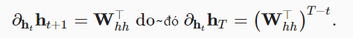
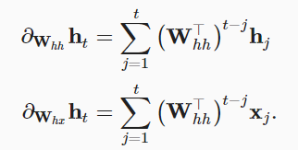
Backpropagation Through Time in detail
Finally, the objective function L depends on model parameters and in the hidden layer via hidden state . To Compute the gradients with respect to such parameters and we apply the chain rule that give:
Hidden state depend on each other and previous inputs:
Using chain rule, we have:

Slide 23
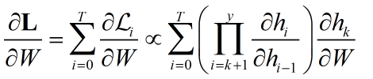
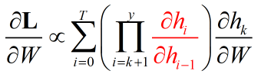
Vanishing/ Exploding Gradients Problem
The training of RNN is not trivial, as we backpropagate gradients through layers and also through time. Hence, in each time step we have to sum up all the previous contributions until the current one, as given in the equation:
In this equation, the contribution of a state at time step k to the gradient of the entire loss function L, at time step t=T is calculated. The challenge during the training is in the ratio of the hidden state:

Slide 24
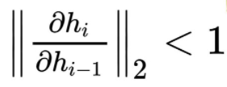
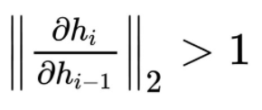
Vanishing/ Exploding Gradients Problem
Two common problems that occur during the backpropagation of time-series data are the vanishing and exploding gradients. The equation above has two problematic cases:
Vanishing Gradient:
If
The term goes to zero exponentially fast, which makes it difficult to learn some long period dependencies. This problem is called the vanishing gradient
Exploding Gradient:
If
The term goes to infinity exponentially fast, and their value becomes a NaN due to the unstable process. This problem is called the exploding gradient.
How do we handle with vanishing/ exploding gradients problem?

Slide 25
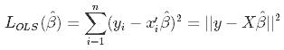
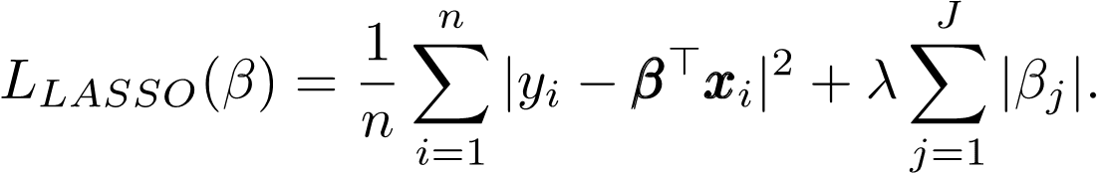
Dealing with Vanishing/ Exploding Gradients Problem
Using L1/ L2 penalty on the recurrent weights can help with exploding gradients.
Given that the parameters initialized with small values, the spectral radius of is probably smaller than 1, from which it follows that the gradient can not explode.
The regularization term can ensure that during training the spectral radius never exceeds 1.
This approach limits the model to a simple regime (with a single point attractor at the origin), where any information inserted in the model has to die out exponentially fast in time. In such a regime we can not train a generator network, nor can we exhibit long term memory traces.
L1 penalty (Ridge regression):
L2 penalty (Lasso regression):

Slide 26
Dealing with Vanishing/ Exploding Gradients Problem
2. Clipping Gradients:
Let us further assume that the objective function is well behaved, say Lipschitz continuous with constant L. That is to say:
In this case we can safely assume that if we update the parameter vector by ηg , then:
Which means that we will not observe a change by more than Lη∥g∥ . This is both a curse and a blessing. On the curse side, it limits the speed of making progress; whereas on the blessing side, it limits the extent to which things can go wrong if we move in the wrong direction.
Sometimes the gradients can be quite large and the optimization algorithm may fail to converge. We could address this by reducing the learning rate η. One popular alternative is to clip the gradient g by projecting them back to a ball of a given radius, say θ via:

Slide 27
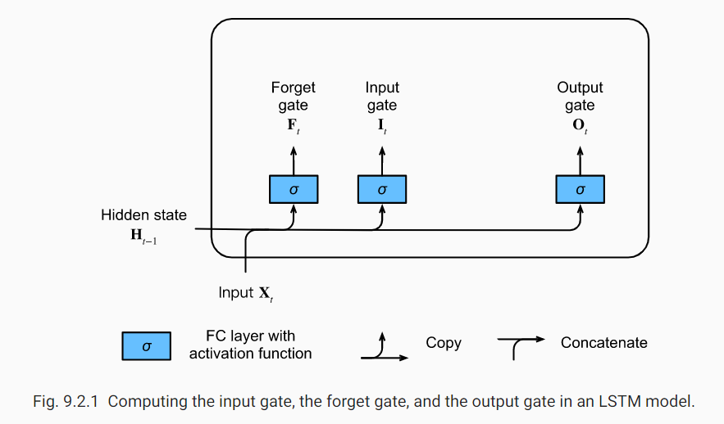
Dealing with Vanishing/ Exploding Gradients Problem
3. Long Short-Term Memory (LSTM):
3.1 : Input Gate, Forget Gate, Output Gate

Slide 28
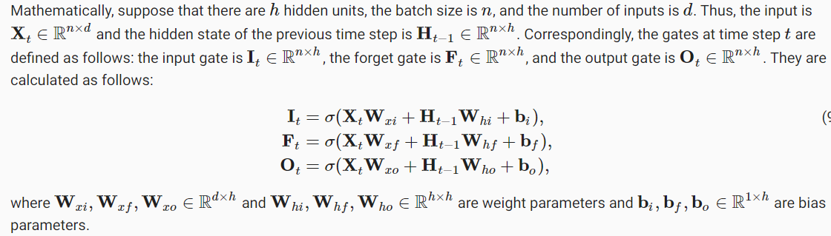
Dealing with Vanishing/ Exploding Gradients Problem
3. Long Short-Term Memory (LSTM):
3.1 : Input Gate, Forget Gate, Output Gate

Slide 29
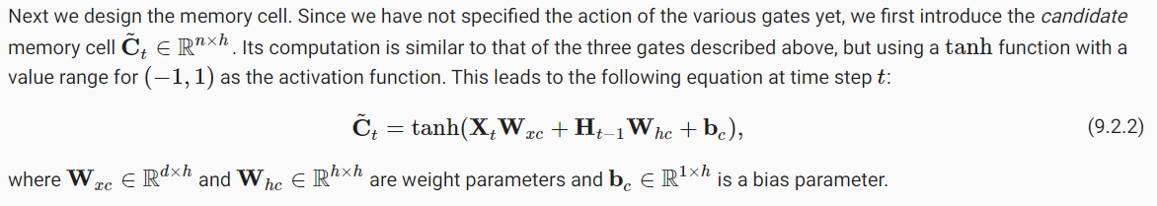
Dealing with Vanishing/ Exploding Gradients Problem
3. Long Short-Term Memory (LSTM):
3.2 : Candidate memory cell

Slide 30
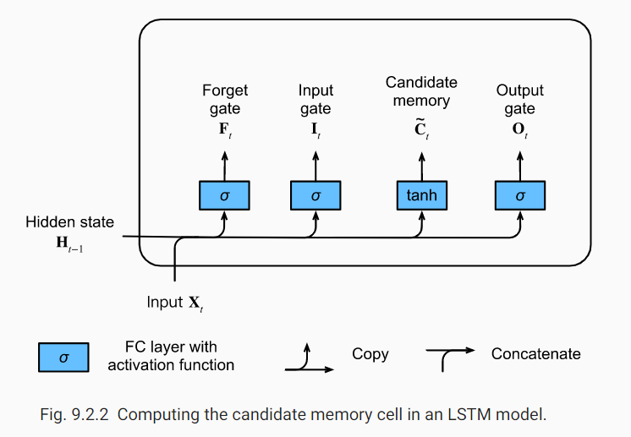
Dealing with Vanishing/ Exploding Gradients Problem
3. Long Short-Term Memory (LSTM):
3.2 : Candidate memory cell

Slide 31
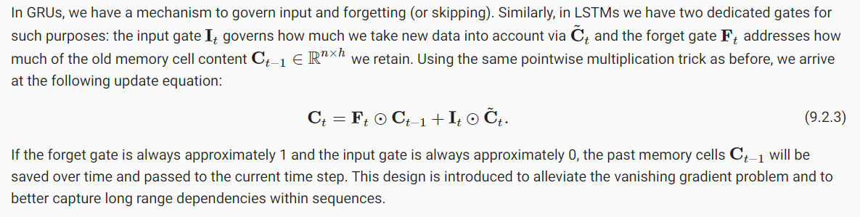
Dealing with Vanishing/ Exploding Gradients Problem
3. Long Short-Term Memory (LSTM):
3.3 : Memory Cell

Slide 32
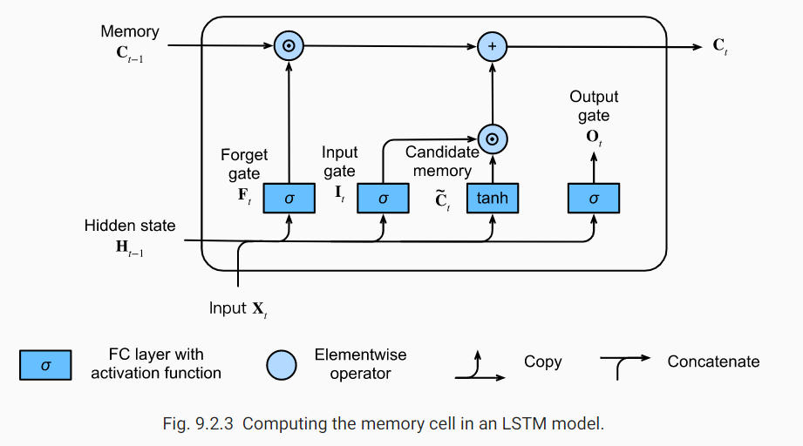
Dealing with Vanishing/ Exploding Gradients Problem
3. Long Short-Term Memory (LSTM):
3.3 : Memory Cell

Slide 33
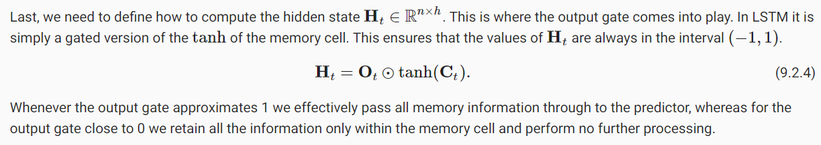
Dealing with Vanishing/ Exploding Gradients Problem
3. Long Short-Term Memory (LSTM):
3.4 : Hidden State

Slide 34
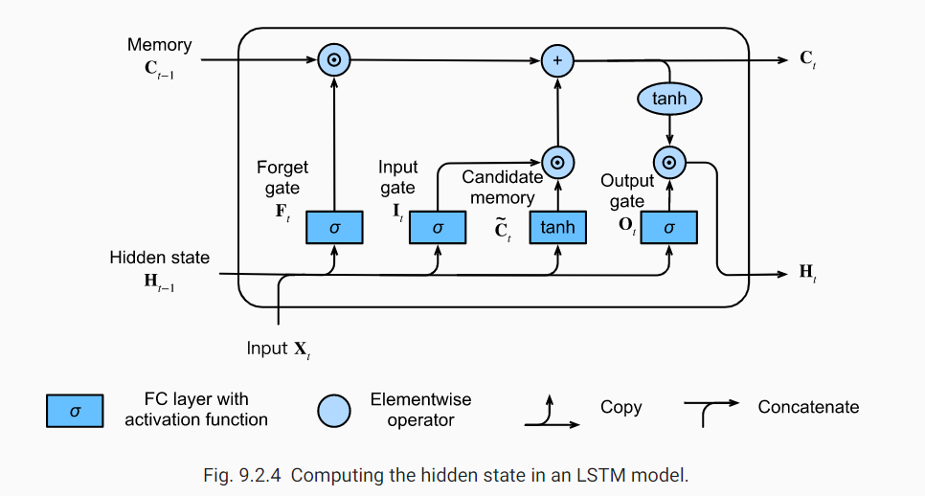
Dealing with Vanishing/ Exploding Gradients Problem
3. Long Short-Term Memory (LSTM):
3.4 : Hidden State

Slide 35
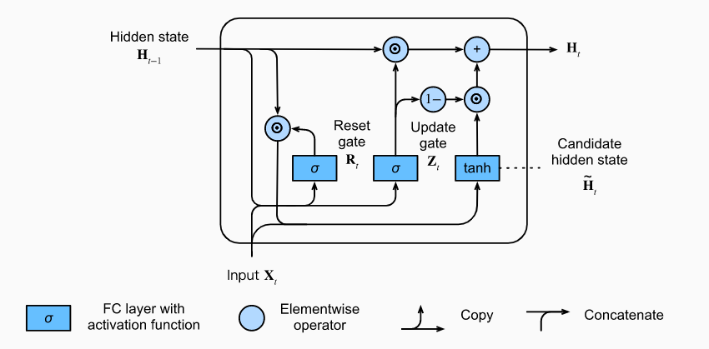
Dealing with Vanishing/ Exploding Gradients Problem
5. Gated Recurrent Units (GRU):
Reset gate and Update Gate:
Candidate Hidden State:
Hidden State:
The key distinction between vanilla RNNs and GRUs is that the latter support gating of the hidden state. This means that we have dedicated mechanisms for when a hidden state should be updated and also when it should be reset.
These mechanisms are learned and they address the concerns listed above. For instance, if the first token is of great importance we will learn not to update the hidden state after the first observation. Likewise, we will learn to skip irrelevant temporary observations. Last, we will learn to reset the latent state whenever needed. We discuss this in detail below.

Slide 36
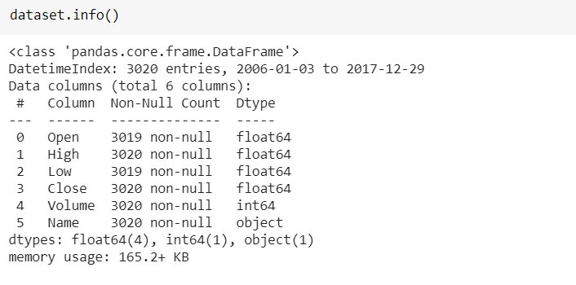
DEMO
Analyze:
Source: DJIA 30 Stock Time Series Kaggle
Dataset: The price of stocks of IBM for the year 2006-2017

Slide 37
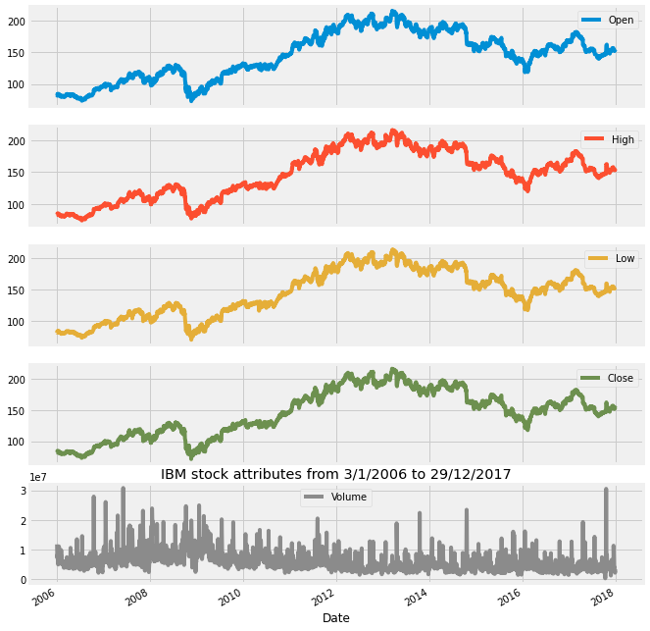
DEMO
Visualize:

Slide 38
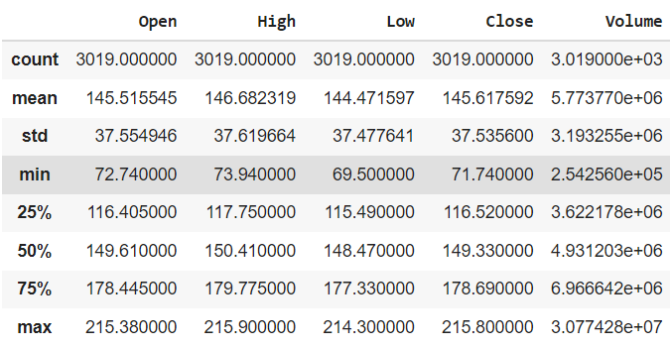
DEMO
Analyze:

Slide 39
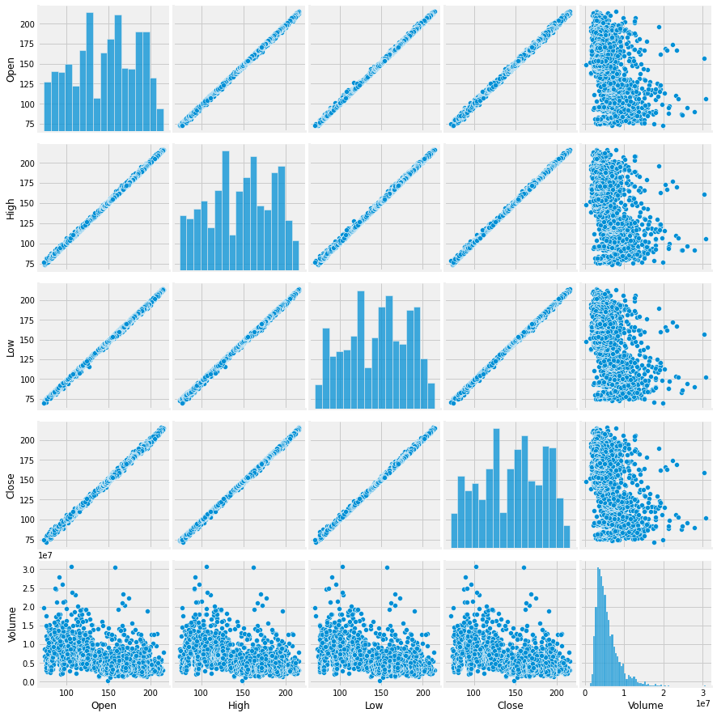
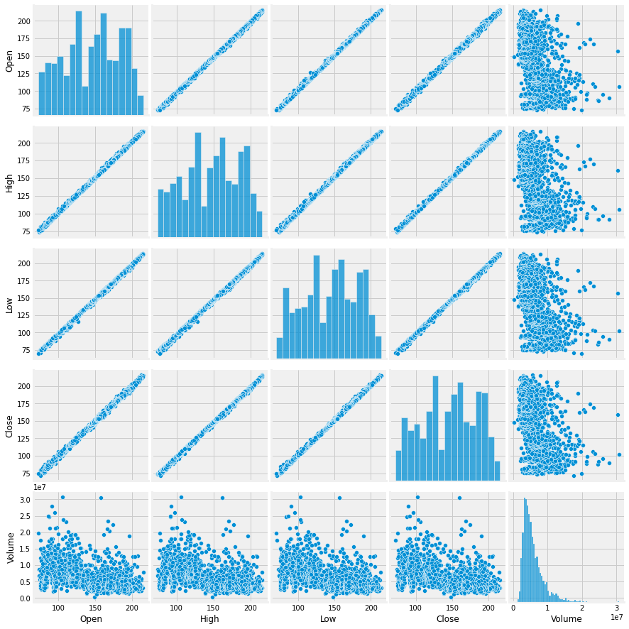
DEMO
Visualize:

Slide 40
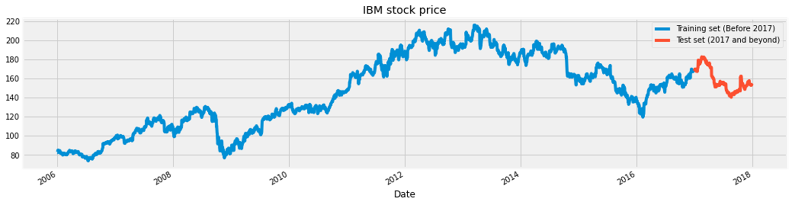
DEMO
Visualize:

Slide 41
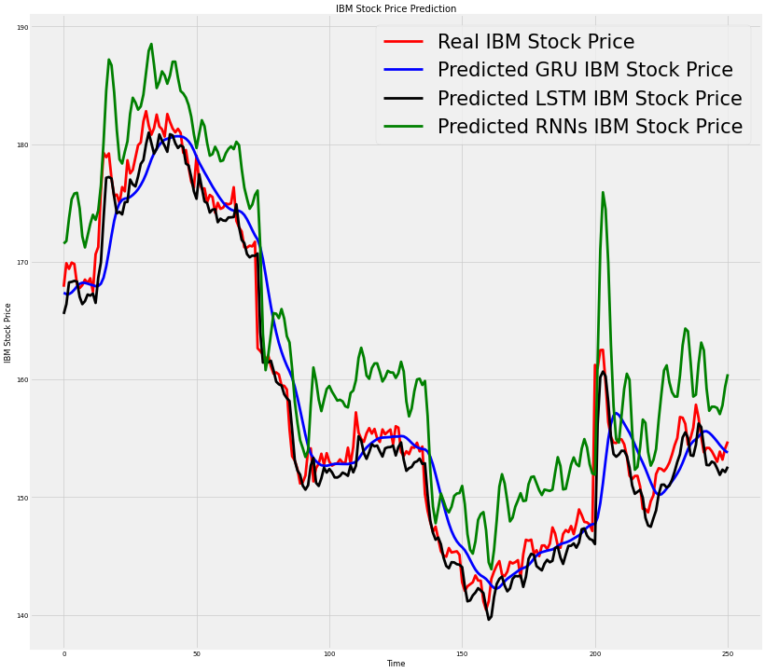
DEMO
Visualize with 3 methods:

Slide 42
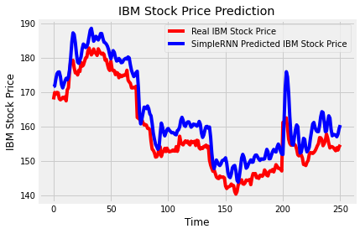
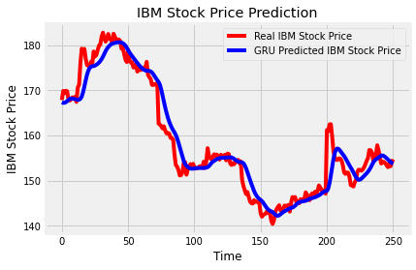
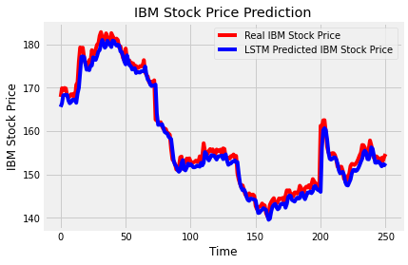
DEMO
Visualize with 3 methods:

Slide 43
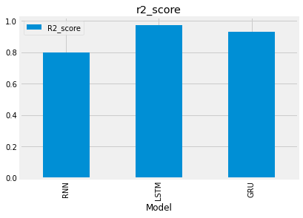
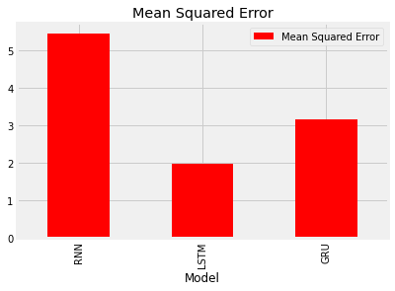
DEMO
Visualize with 3 methods:

Slide 44
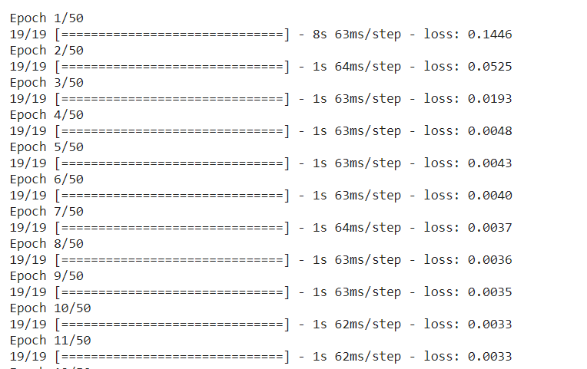
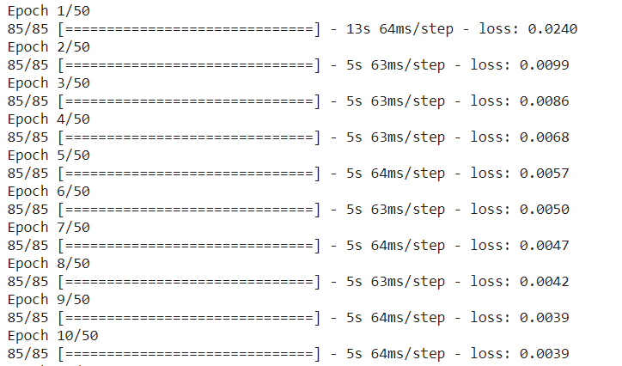
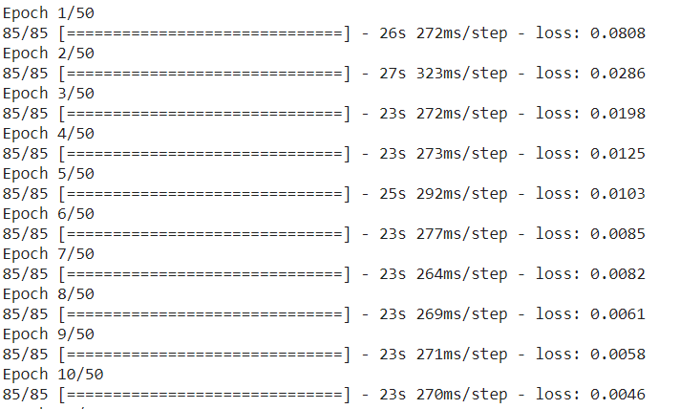
DEMO
GRU
LSTM
RNN

Slide 45
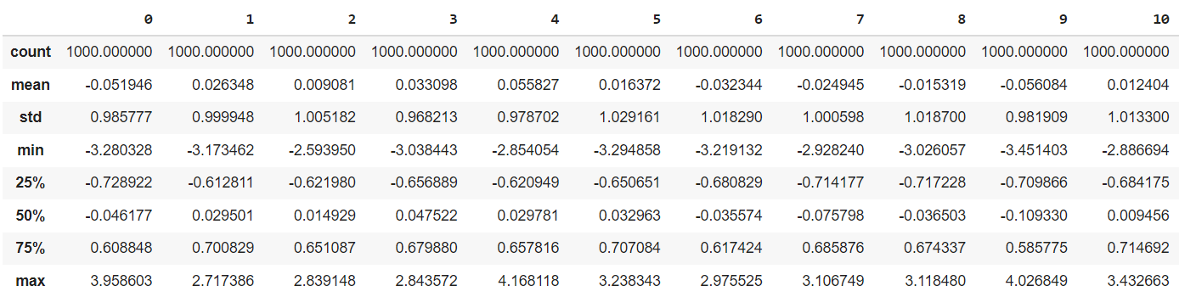
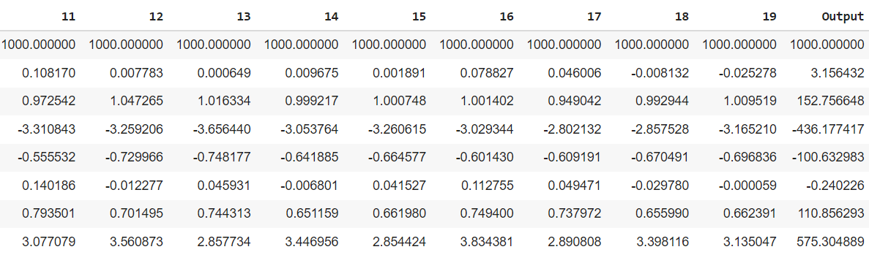
DEMO
For exploding gradient:

Slide 46
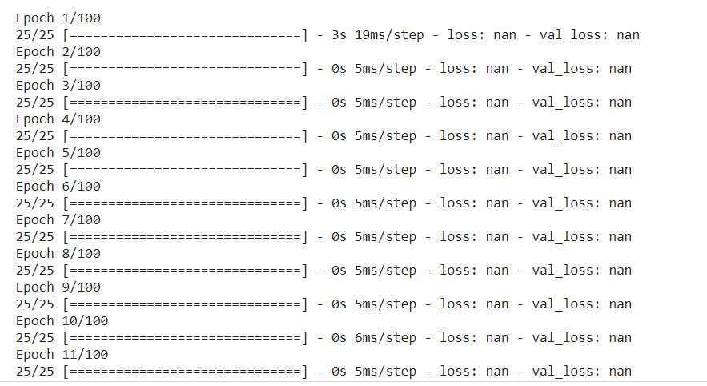
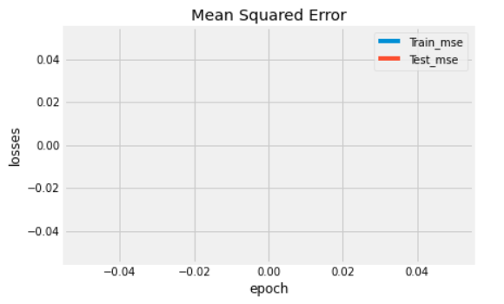
DEMO
For exploding gradient:

Slide 47
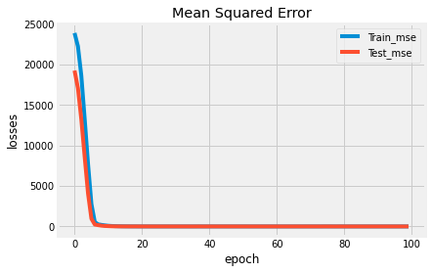
DEMO
Gradient clipping by norm:
clipnorm=1
Result after 100 epochs

Slide 48
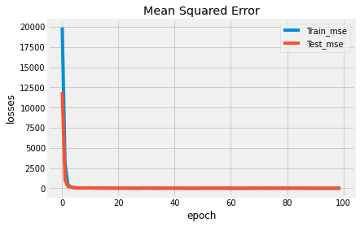
DEMO
Gradient clipping by value:
clipvalue=0.8
Result after 100 epochs

Slide 49


THANK YOU FOR WATCHING!

